Slide 1
Social engineering
By:
يوسف محمد عباس عبدالوهاب
محمد مفاز محمد طلعت
عبده رفعت عبده
يسري عصام ايوب
يوسف محمد مرسي

Slide 2
What is social engineering
Social engineering is the term used for malicious activities accomplished made through human interactions.
It uses psychological trick to make users do security mistakes or giving sensitive information.

Slide 3
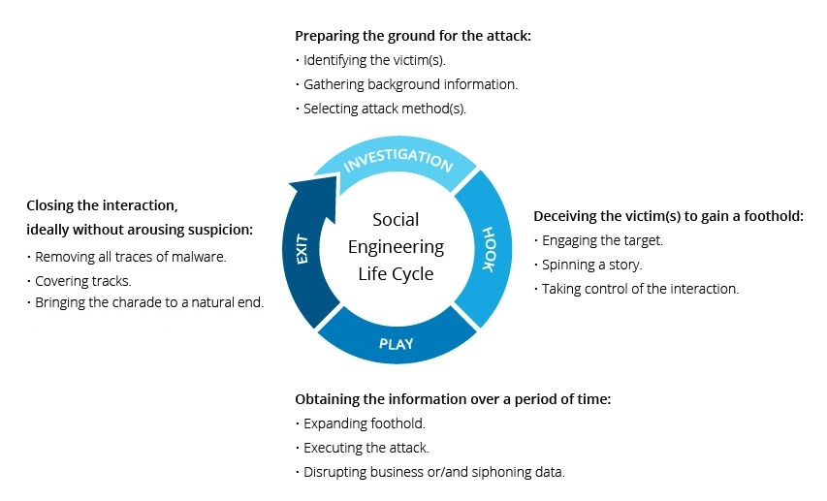
Social engineering lifecycle

Slide 4
Social engineering has multiple steps
it happens due to human mistakes
So it is hard to deceive every one in the same way
for that it happens in one or more than step.

Slide 5
1-Preparing the ground for the attack
Identify the victim
Gathering background information
Selecting attack method

Slide 6
2-Deceiving the victim to gain foothold
Engaging the target
Spanning a story
Taking control of interactions

Slide 7
3-Information Obtaining over a period of time
Expanding foothold
Executing the attack
disrupting business and sensitive data

Slide 8
4-Closing the interaction without arousing suspicions
Removing all traces of malware
Converging tracks
Bringing charade to natural end

Slide 9
Danger of social engineering
social engineering danger beeing in it's relys on human error rather than a fault in software or operating system.
Mistakes made by legitimate users are much less predictable, making them harder to identify the attacker.

Slide 10
Social engineering attack techniques
Social engineering attacks come in many different forms and can be performed anywhere where human interaction is involved. The following are the five most common forms of digital social engineering assaults.

Slide 11
1-Baiting
baiting attacks use a false promise to attract a victim’s greed or curiosity . They trap victims and steals their personal information or inflicts their systems with malware.

Slide 12
2-Scareware
Scareware involves victims being bombarded with false alarms and fictitious threats. Users are deceived to think their system is infected with malware, prompting them to install software that is malware.

Slide 13
3-Pretexting
Here an attacker obtains information through a series of cleverly crafted lies. The scam is often initiated by a perpetrator pretending to need sensitive information from a victim so as to perform a critical task.
The attacker usually starts by establishing trust with their victim by impersonating co-workers, police, bank and tax officials, or other persons who have right-to-know authority. The attacker asks questions that are ostensibly required to confirm the victim’s identity, through which they gather important personal data.

Slide 14
4-Phishing
As one of the most popular social engineering attack types, phishing scams are email and text message campaigns aimed at creating a sense of urgency, curiosity or fear in victims. It then prods them into revealing sensitive information, clicking on links to malicious websites, or opening attachments that contain malware.

Slide 15
5-Spear phishing
This is a more targeted version of the phishing scam whereby an attacker chooses specific individuals or enterprises. They then tailor their messages based on characteristics, job positions, and contacts belonging to their victims to make their attack less conspicuous it requires more effort on behalf of the perpetrator and may take weeks and months to pull off. They’re much harder to detect and have better success rates if done skillfully.

